Slide 1
Introduction to Computation and Programming
By: Iman Khani Jazani
- Senior Data Scientist, Adin - Technical AI Product Manager and Advisor, Mehra - Adjunct Professor, Sharif University of Technology

Slide 2
Today
Course information
What is computation?
What is programming?
Some Python applications
Python in Research and industries

Slide 3
Course Information

Slide 4
Grading
Approx. 20% Programming Assignments
Approx. 2% Challenging Questions and Contributions in Class
Approx. 13% Mid-term Project (alone)
Approx. 35% Final Project (team work~5 member)
Proposal (about real needs)
Coding
Release
Approx. 30% Final Exam
Approx. 5% Presentation with Code(extra score)

Slide 5
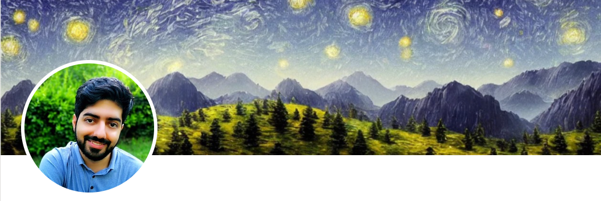
Contact me
Gmail: ImanKhaniJazani@gmail.com
LinkedIn: https://www.linkedin.com/in/ImanKhaniJazani/
Telegram: @IKJ1992

Slide 6
Main links for our class
Telegram group: t.me/SharifPythonSpace1401
Github organization: github.com/SharifPythonSpace

Slide 7
Together
Send your feedback about the class whenever you want!

Slide 8
Course plan
Fundamental concepts in computer science
Algorithm thinking
Coding with Python
Some meetings with Python experts in different domain (may be)

Slide 9
Be in path
Programming Language
Knowledge of Concepts
Algorithm Thinking

Slide 10
TAs plan
?

Slide 11
What is Computation?

Slide 12
Lecture Resources

